Slide 1
Fin_Wise
AI Agent for Digital Financial Literacy
Presented by: Vaishnavi eknath Aher
College Name: Mitaoe

Slide 2
Index
Problem Statement
Proposed Solution
System Development Approach
Algorithm And Deployment
Result
Conclusion
Future scope
References

Slide 3
Problem Statement
- Many users lack basic understanding of digital financial tools.
- High risk of online scams and fraud due to low awareness.
- Financial jargon like 'interest rates' or 'budgeting' confuses users.
- Language barriers prevent access to accurate financial info.
- Lack of structured education around personal finance in schools.
- Many first-time internet users are unfamiliar with online banking safety.
- Rise in phishing attacks targeting low-literacy users.
- Financial literacy programs are often not available in regional languages.

Slide 4
Solution – Fin_Wise
- An AI-powered digital assistant to educate users on finance.
- Built with RAG (Retrieval-Augmented Generation).
- Provides personalized, easy-to-understand financial advice.
- Multilingual support to reach all demographics.
- Uses AI to simplify complex financial topics.
- Retrieves updated data from official portals like RBI, NPCI, etc.
- Custom responses based on user's profile and financial goals.
- Breaks down information into easy steps or voice responses

Slide 5
System Development Approach Technology Stack
- IBM Granite for powerful language understanding.
- IBM Cloud Lite for scalable deployment.
- RAG (Retrieval-Augmented Generation) for accurate info fetching.
- Translation APIs for multilingual interaction.
- Web/Mobile frontend for user access.
- ElasticSearch or Watson Discovery to power document retrieval.
- Node.js backend with REST API for modular structure.
- Data encryption to ensure user privacy.
- Optional integration with Aadhaar/UPI for verification.

Slide 6
Algorithm & Deployment
Algorithm:
- RAG for fetching verified financial knowledge
- NLP pipeline for multilingual processing
- Ranking algorithm to prioritize trusted results
Deployment:
- Hosted on IBM Cloud Lite infrastructure
- Integrated with IBM Granite
- Web and mobile chatbot with authentication
- Continuous monitoring with regular updates

Slide 7
Result
The AI Agent demonstrates:
- Accurate retrieval of financial information
- Multilingual support for inclusivity
- Awareness-building for fraud prevention
- Increased confidence in using UPI and digital finance
(Output screenshots of chatbot answering financial queries can be added here)

Slide 8
Conclusion
The AI Agent for Digital Financial Literacy empowers users with secure, reliable,
and multilingual financial knowledge. It bridges the digital divide by making
financial literacy accessible, protecting users from scams, and encouraging
responsible use of financial tools.

Slide 9
Future Scope
- Integrate voice and WhatsApp chatbot features.
- Expand language coverage across India.
- Partner with financial literacy programs and NGOs.
- Add gamified learning for youth engagement.
- Introduce visual aids like charts and infographics.
- Rewards system for completing learning milestones.
- AI voice assistant in regional dialects.
- Integration with real-time news on financial scams.

Slide 10
References
1. Reserve Bank of India (RBI)
2. NPCI – National Payments Corporation of India
3. Ministry of Finance – Government of India
4. IBM Cloud Lite Documentation
5. IBM Granite RAG Lab Documentation

Slide 11
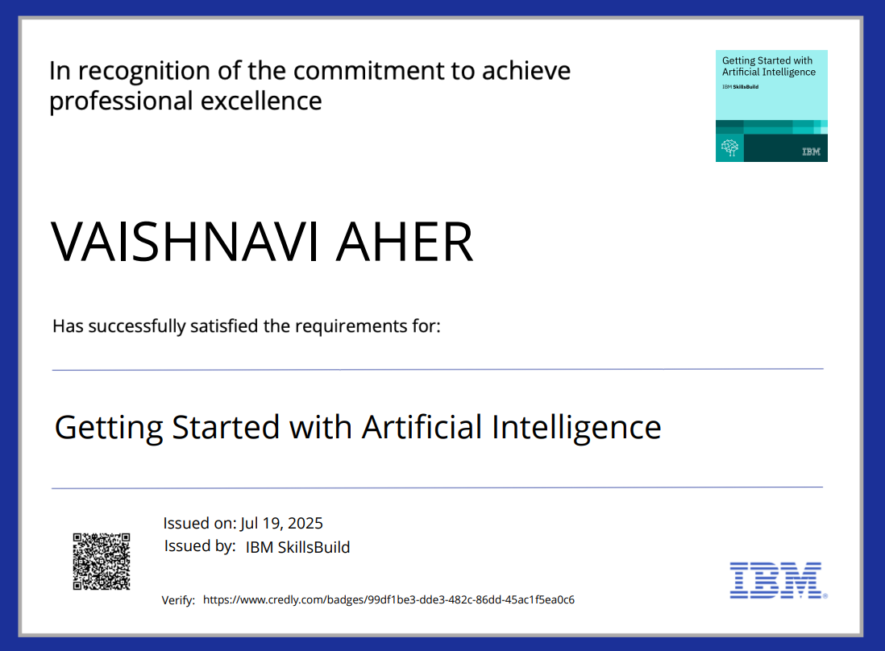

Slide 12
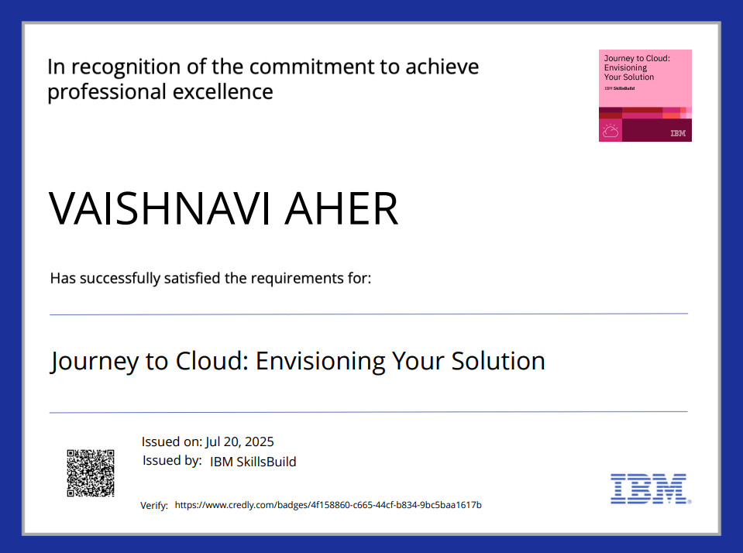

Slide 13
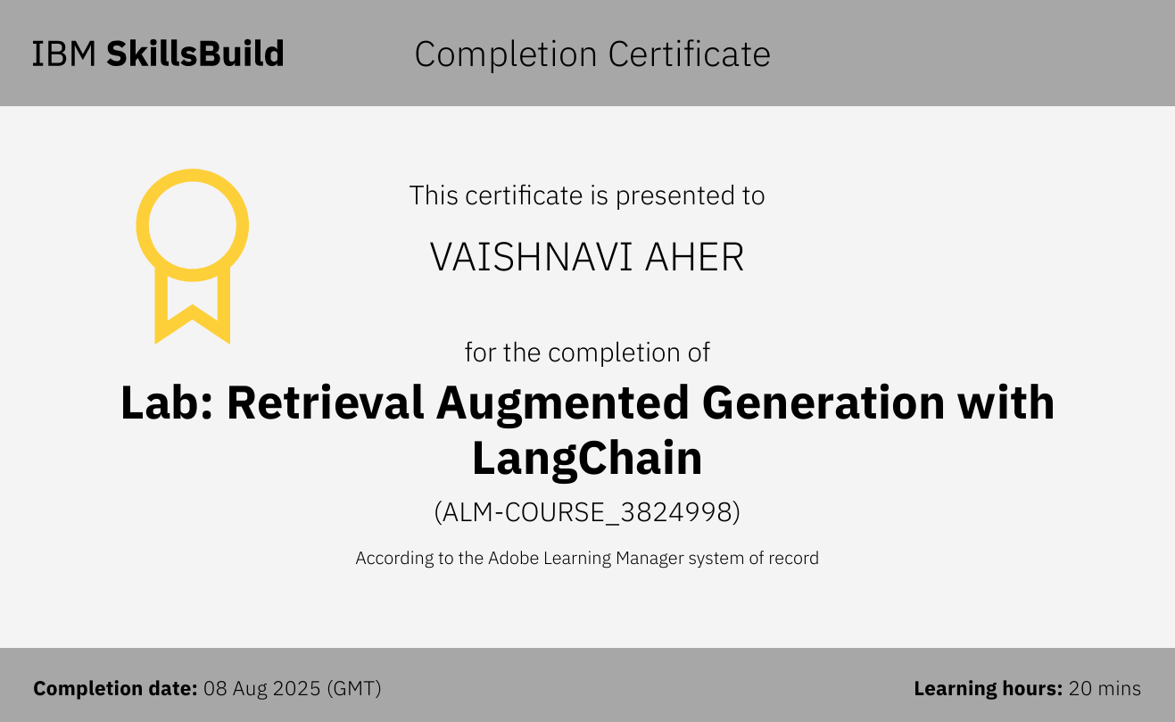

Slide 14
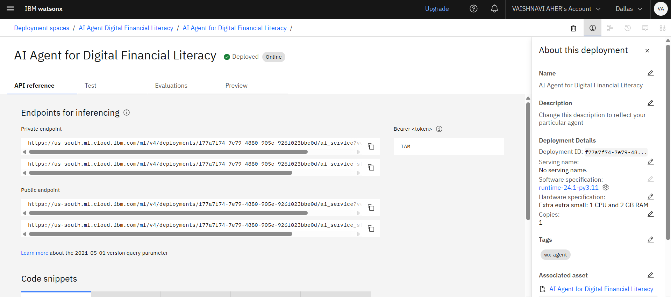

Slide 15
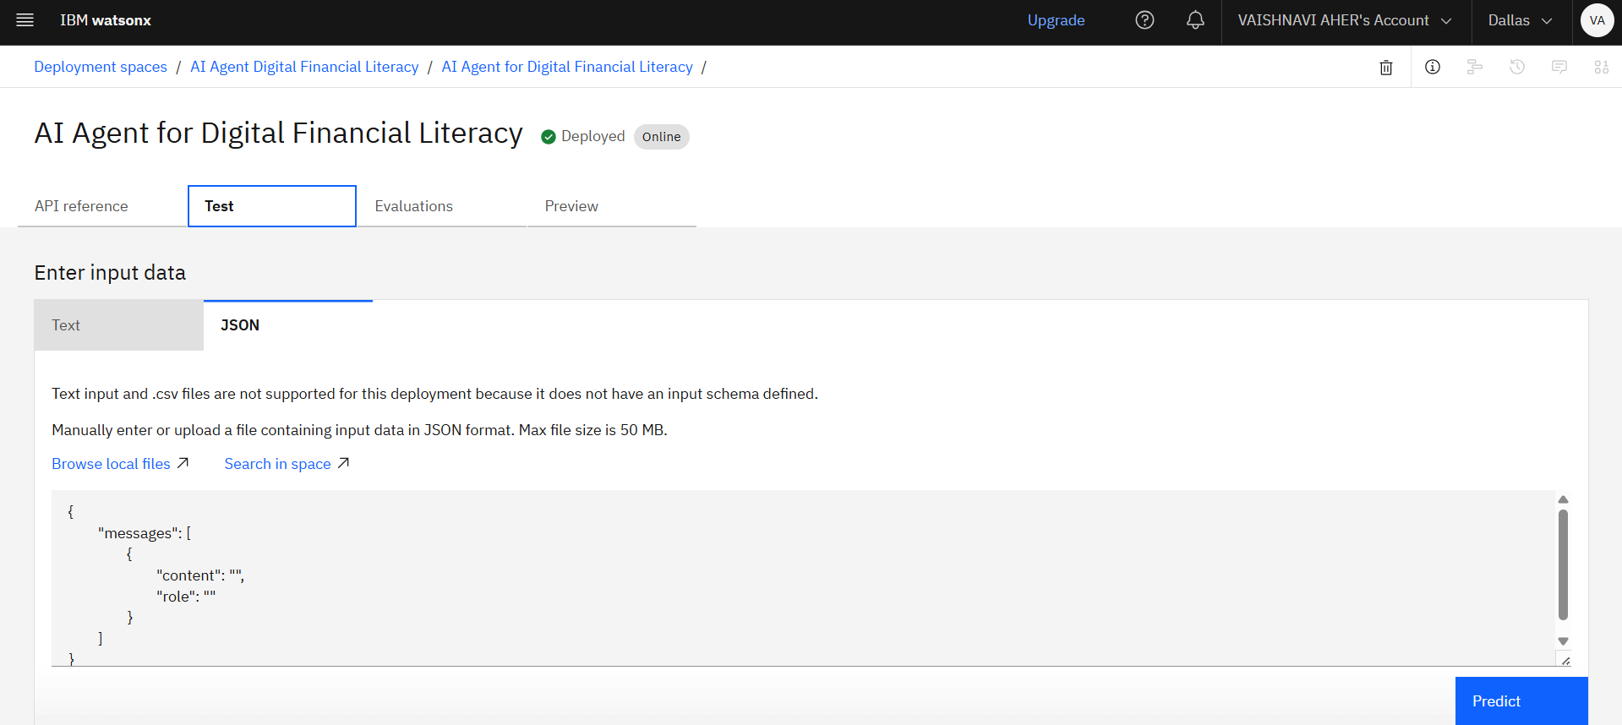

Slide 16
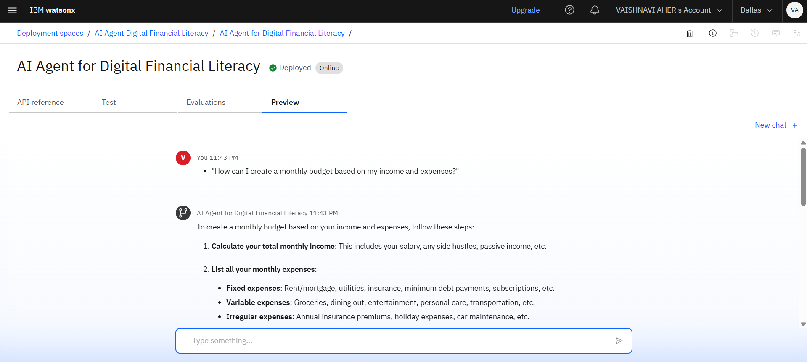

Slide 17
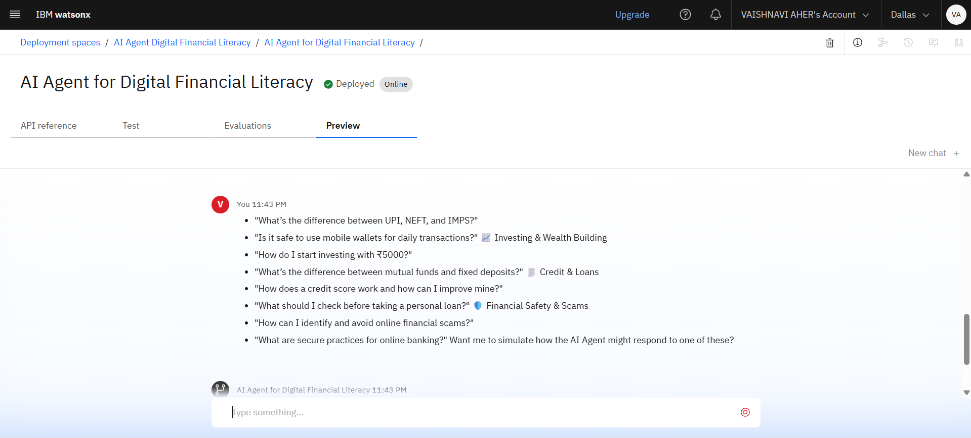

Slide 18
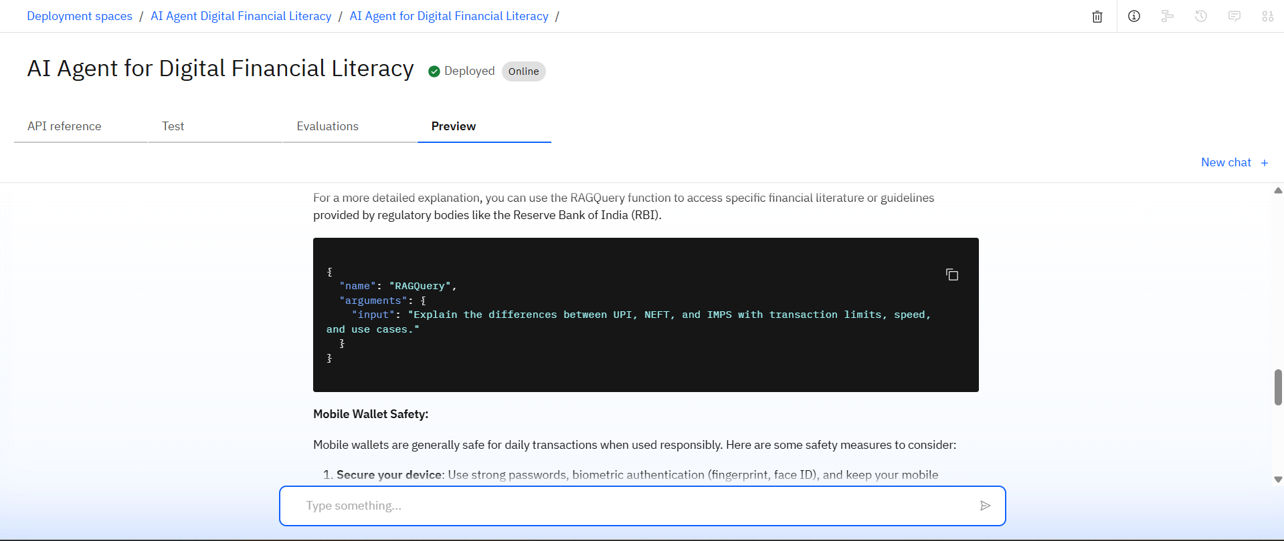

Slide 19
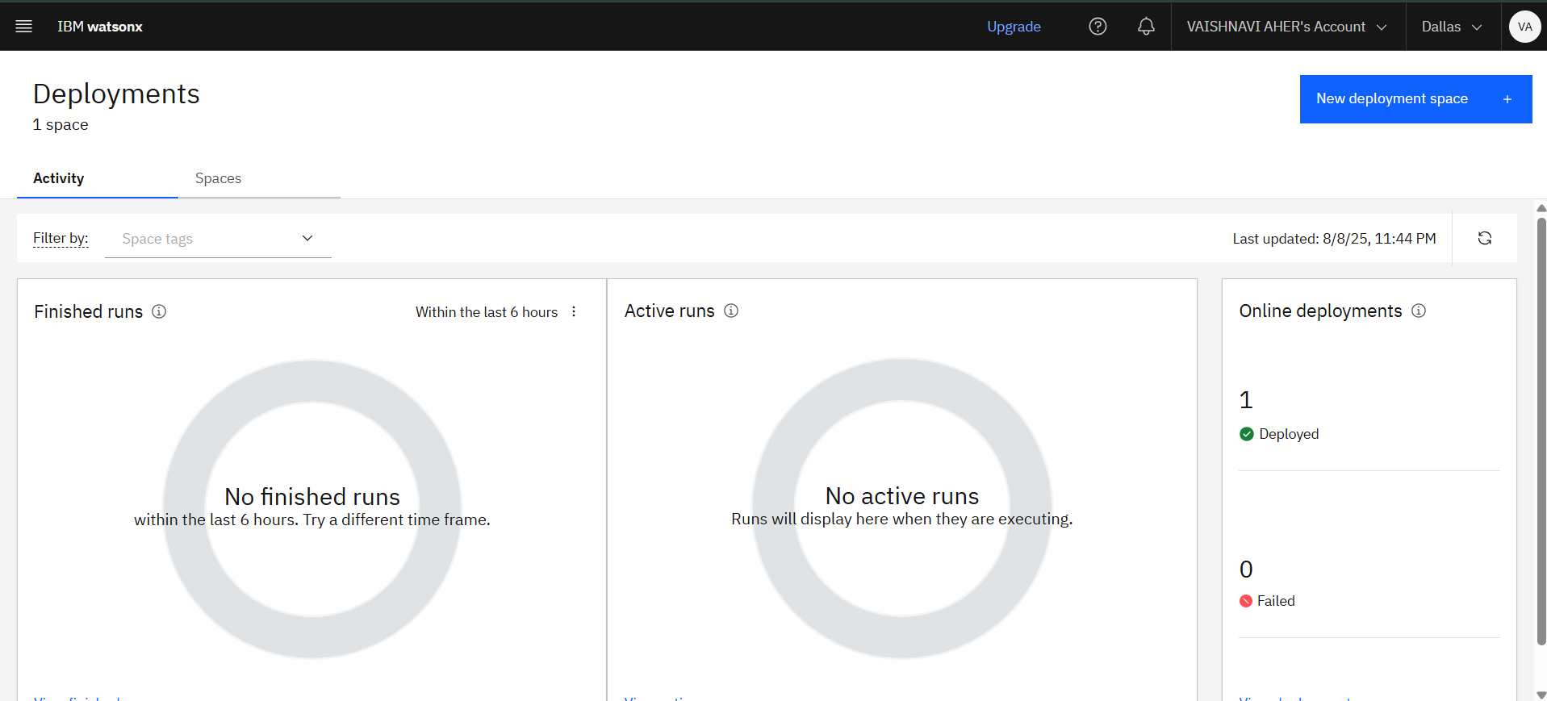

Slide 20
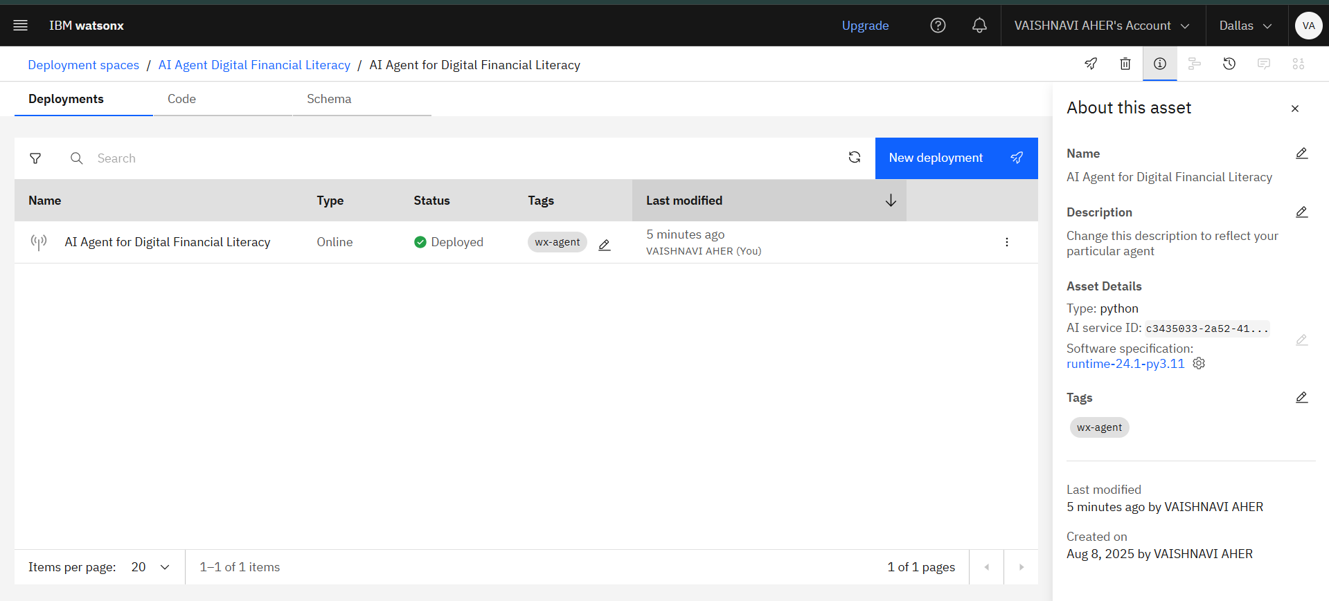

Slide 21
Thank You

